Slide 1
Muslim rule in South Asia
Rise of Muslim rule in South Asia
Muslim Reformist Movements
Decline of Muslim rule and rise of British colonialism

Slide 2
Advent of Islam in India
Muhammad Bin Qasim (712-997)
Extended the Muslim rule from Debul (Karachi) to Multan
Mahmud of Ghazni (1000-1185)
Muhammad Ghauri (1185-1192)
Reached the regions of Bihar and Bengal
Delhi Sultanate (1192-1526)
Sufis started to come in India to preach Islam
Mughal Empire (1526-1757)
Mujadid Alif Sani (1564-1624)
Rise of British colonialism in South Asia.

Slide 3
Sindh The gateway of Islam
The first invasion of Arabs in South Asia took place in Makran coast by the end of the rule of Hazrat Umar in 644.
Makran came under the rule of the Arabs during the Ummayids Caliph Mawyia (661-680).
Arabs were involved in trade with South Asia through Indian Ocean. Many Arabs were also settled in Malabar coast of South Asia. Many of them were involved in the Khilafat movement in 1922.
At that time, the Muslims arrived in South Asia due to the network of trade.
In 712, Raja Dahir was ruling Sindh when the pirates captured the ship of the Arabs.

Slide 4
The ship was carrying families of Arab merchants and some gifts for the Ummayid governor of Iraq Hajjaj Bin Yousaf.
Hajjaj Bin Yousaf asked Raja Dahir to give him the ship back but he refused and asked Hajjaj that if he wanted to get it back he should fight for it. Initial attempts of Hajjaj were failed to recover the ship.
Hajjaj bin Yousaf then send his nephew Muhammad Bin Qasim who arrived in Sindh via route of Makran.
He confronted Raja Dahir at Debul (near Manora islands in Karachi).
He defeated Raja Dahir but the wife of Raja Dahir, Rani Bai, moved to the fort of Rawar ( Nandi Kot Thatta) with 15,000 soldiers. But when Muhammad Bin Qasim encircled the fort she surrendered.
Muhammad Bin Qasim conquered from Debul (karachi) area up to Multan. He levied tax of 12 dirhams.

Slide 5
He gave non-Muslims the status of dhimmis. They were levied with Jizya tax. After paying Jizya the non-Muslims were not required to take part in the battles of the Muslims.
The Turkish Muslim dynasty was flourishing in Gazni (Afghanistan) by 1000. Mahmud of Ghazni succeeded his father subtukin.
From 1000 to 1026 he launched 17 expeditions in India and destroyed the Hindu temples. However, with the rise of the Ghor under Muhammad Ghori in 1185 the last ruler of Ghaznavid, Khusru malik, was defeated.
Under Muhammad Ghori Islam spread up to Bengal and Bihar. After him Delhi sultans established their rule in South Asia. their rule lasted from 1192-1526.

Slide 6
In this way, northern parts of South Asia Turkish and Persian rule variants were established; in south the Arab variant was developed.
In 1526, Mughal rule was established, when Baber defeated Ibrahim Lodhi of Delhi Sultanate.
In the reign of Akbar, the Gujrat was conquered that meant that they were able to get control of the Surat Port in Gujrat by 1574. Moreover, the conquest of Bengal gave Mughals control over vast swathes of agricultural lands.
The Mughal expanded their rule to the south up to the deccan and Golconda, it was during Aurangzeb that the empire was more expanded by the year 1690. but the expansion of the Mughal rule was not uncontested rather the people resisted the expansion of the Mughal rule for example the Marathas in the south. Shivaji resisted the expansion of the Mughal rule

Slide 7
Unlike the contemporary rulers of ottomans and the Safavid land-based empires, the Mughal rule differed based on the population that it ruled. that is most of the population under the Mughal empire was non-Muslim as a result of which the Mughal rule was dependent on the alliances with the Hindu Rajput.
Although the nobility of the Mughals consisted of the Turks afghans and Persians, but they also constructed a network of alliances with the Hindus.
During Aurangzeb the territorial boundaries of the Mughals stretched to farthest extent. military campaigns were launched that lead to financial crisis
The Hindu Muslim farmers as well as the Jain and Hindu merchants and bankers who provided critical financial support to the Mughal rule started to assert their autonomy.

Slide 8
Although the rulers patronized the Sufis and other religious places, but it was not like that of the church and the state relationship.
Sufis played vital role in expansion of Islam without the patronage of the King.
They started to come from the time of Mahmud of Ghaznavi: Ali Makhdum Hajweri, Bahauddin Zakariya, Shiekh Farid Uddin Ganj shakar, Nizamuddin Auliya, etc.
Mujadid Alaf Sani (Sheikh Ahmed Sirhindi) (1564-1624)
Imam Rabbani Hazrat Mujadid Alaf Sani was born in Sirhind in eastern Punjab. He was descendent of Hazrat Umer, and belonged to Naqsbandiya silsila. He memorized Quran and studied Tafsir, Hadith, and Philosophy.

Slide 9
Mughal Emperor Akbar was ruling at that time in sub-continent. The ulema argued that he had deviated from the Islamic thought to consolidate his rule in sub-continent. He was including the Hindu practices in Islam.
He married many Hindu women, who kept temples inside the royal palace. He appointed many Hindu Rajputs on higher posts in his government
Shiekh Ahmed wrote many letters to the Ulema and the Islamic scholars of the court to follow the Islam properly. The Philosophy of Wahdat-ul-Wajood was presented by some Sufi saints during the reign of Mughal Emperor Akbar. They believed that the entire universe is the symbol of Allah, and source of revelation of God’s sovereignty.

Slide 10
The Philosophy of Wahdat-ul-Wajood was presented by some Sufi saints during the reign of Mughal Emperor Akbar. They believed that the entire universe is the symbol of Allah, and source of revelation of God’s sovereignty. The supporters of this school of thought argued that there was no living difference between the man and the God, and both the individual and the God are not separate from each other. They believed that every particle of the Universe represented God, due to which they could also be worshipped.
Shiekh Ahmed negated these teachings, while presenting his own view of this philosophical question. He introduced the philosophy of Wahdat-ul-Shahood. In which he argued that the creater and the creatures are different from each other. They in no way could ne merged.

Slide 11
The British East India Company and the conquest of India (1757-1857)
What is colonialism?
The term colonialism is derived from the Latin word colonus which means farmer.
Transfer of population from one territory to another, where the arrivals lived as permanent settlers while maintaining allegiance to country of origin.
Imperialism is derived from Latin word Imperium, means to command.

Slide 12
It refers to how a country exercises power over other country whether through settlement, or indirect control.
Colonialism is not a modern phenomenon. E.g ancient Greeks colonized Romans. Ottomans colonized large territories of North Africa and Middle East.
However, the European colonialism differs from the earlier forms of colonialism to the advancement in the sailing ships. They colonized far off territories and colonized remote parts of the world.
The Europeans colonialism could be traced back to the colonization of America by Spanish conquistadors in 16th century.
The Church justified the colonialism as a religious mission to bring Christianity to the native people. The habits of the native people were termed as uncivilized. Hence, the aim was to civilize the people along with changing their religion.

Slide 13
The era of enlightenment changed the thinking pattern in the western European countries like Britain, France, Germany.
The Enlightenment principle argues that the individual is capable of reason and self-government.
But the same Europeans who adhered to the idea of rational human being capable of self-government.
The idea of nationalism was also emerged in Europe on the basis of shared culture.
But the European countries considered the native people as incapable of developing rational thinking based on reason due to which they colonized them and justified their colonialism on the basis of civilizing mission.

Slide 14
British Colonialism in South Asia
The beginning of the British political influence over India could be traced back to the fall of Siraj-ud-daula. In 1757, The British defeated the ruler of Bengal in the battle of Plassey and assumed the control of Bengal. Bengal was the most fertile and the richest of the Indian provinces. Its industries and the commerce were well developed. The East India Company and its servants had highly profitable trading interests in the province.

Slide 15
The Mysore state was ruled by Haider Ali, Hyderabad state was ruled by Nizam, and Marathas ruled the regions adjoining the Delhi. In 1766, British tried to make alliance with the Nizam of Hyderabad to attack Mysore. In 1775, The British also attacked Marathas to extend their control over the western regions of India. They war between the Marathas lasted from 1775-1782.
The Nizam, Haider Ali, and the Marathas formed a powerful alliance to counter the British policy of divide and rule. However, The British were successful in creating division between them. Haider Ali a.k.a Tipu sultan was left alone to fight the British. The war started between them and the British in 1789 and ended in 1792. Tipu Sultan was defeated and Mysore was brought under the control of the British.

Slide 16
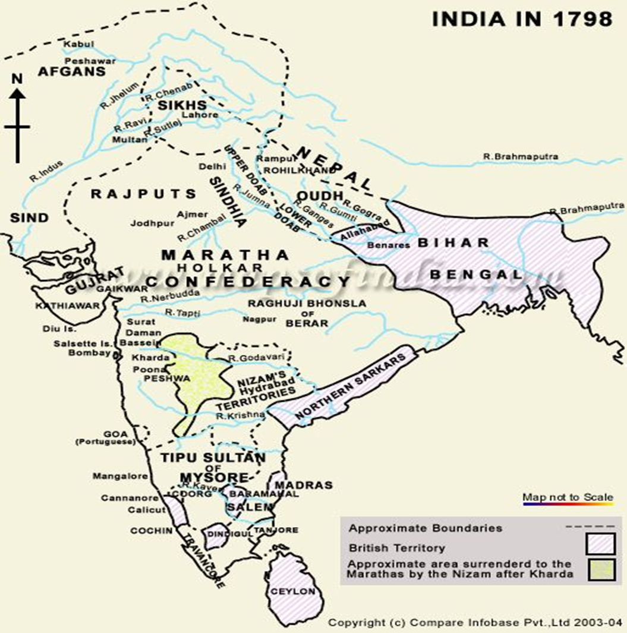

Slide 17
By the year 1818, all these states were brought under the control of the British East India Company. Only the region of Punjab and Sindh was not occupied by them. The region of Sindh and Punjab was important for countering the influence of Russia in the region. The importance of river Indus for the purpose of trade was also considered by the British East India Company.
The British defeated the Talpur rule in Sindh in 1843, and The Sikh rule in Punjab in 1849. However, the British rule was not uncontested in India. In 1857, the Indians rebelled against the British rule. But the British was successful in crushing the rebellion and establishing direct rule of Queen of Britain.

